Slide 1
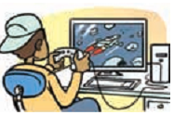
What are the benefits of using computer for leisure activities?
- a fast and convenient way to get and send information.
- ….
What is he doing?

Slide 2
What are the harmful things using computer may bring us?
- harmful to eyes
tired and dizzy …
- Waste of time and money

Slide 3
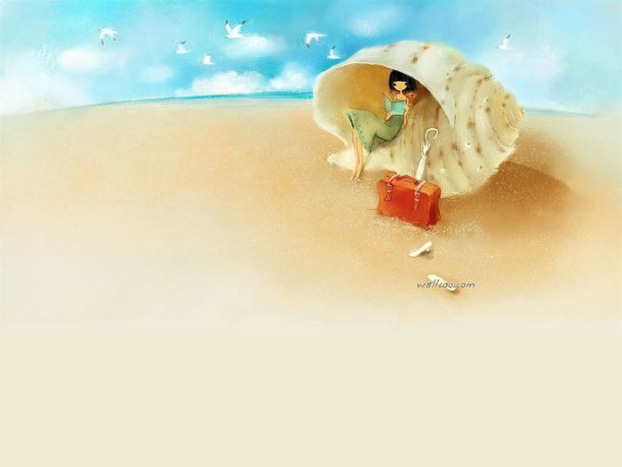
Unit 1:
Leisure activities
Lesson 7 – Skills 2

Slide 4
I. Listening.
1. What do you usually do with your friends in your free time?
Name | Activities
I usually go to the library with my friends.
I
Nam
He usually plays badminton with his friends.
Hoa
She usually chats with her friends.

Slide 5

2. Listen and answer the questions.
What is the topic of this week’s programme?
2. Which two main ways does the programme suggest you can hang out with your friends?
The topic of this week’s programme is hanging out with your friends.
There are two main ways: hanging out indoors or outdoors.

Slide 6
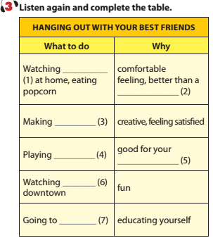

movies
cinema
crafts
sports
physical health
people
cultural centres

Slide 7
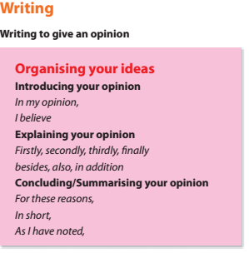

Slide 8
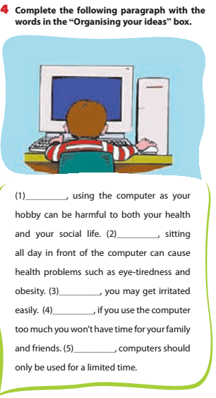
In my opinion
Firstly
Secondly
In addition
For these reasons

Slide 9
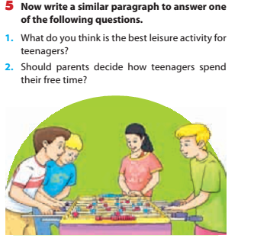

Slide 10
Example:
I believe the best leisure activity for teenagers is any group activity. This could be playing a team sport or joining a hobby group or even volunteering. Firstly, teenagers like to feel that they belong to a group. Secondly, being part of a group helps teenagers make friends. Friendships are very important to teenagers. In addition, they will make friends with people who have the same interests as them. For these reasons I think group activities are best for teenagers.

Slide 12

HOMEWORK
+ Learn the structures by heart.
+ Do exercises in workbook.
+ Prepare for:
Unit 1 – Looking Back.

